Slide 1
MIKE 11
Cross Section Editor

Slide 2
CROSS SECTION EDITOR
Editor and Database of Cross-Sections
Network Editor (.nwk11)
Cross Section Editor (.xns11)
Simulation Editor (.sim11)
Boundary Editor (.bnd11)
Parameter Editor (.HD11)
Time Series Editor (.dfs0)

Slide 3
CROSS SECTION EDITOR
Database Definition
The Database File:
  Is Binary (cannot be viewed in a Text Editor)
  Can hold many Cross-Sections, each identified by:
    River Name (Branch)
    Topographical Identifier (Topo ID)
    Chainage (increasing in downstream direction)
A Single Cross-Section Includes:
  Information on Section and Radius Type
  Raw Data (X,Z-values defining the bed level)
  Information of Lateral Roughness Formulation
  Markers defining extent of the Cross-Section
  Processed Data tables including
    Hydraulic Radius
    Area and Storage Width
    Conveyance
Raw Data View
Processed Data View
(calculated from Raw Data
and used in Simulation)

Slide 4
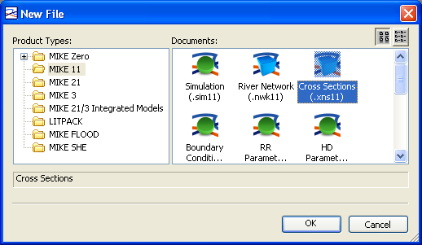
CROSS SECTION EDITOR
*.XNS11 File Extension
How? MIKE Zero -> File -> New -> File -> MIKE 11 -> Cross Sections (.xns11)
Cross-Section Editor
Displays Raw and
Processed Data

Slide 5
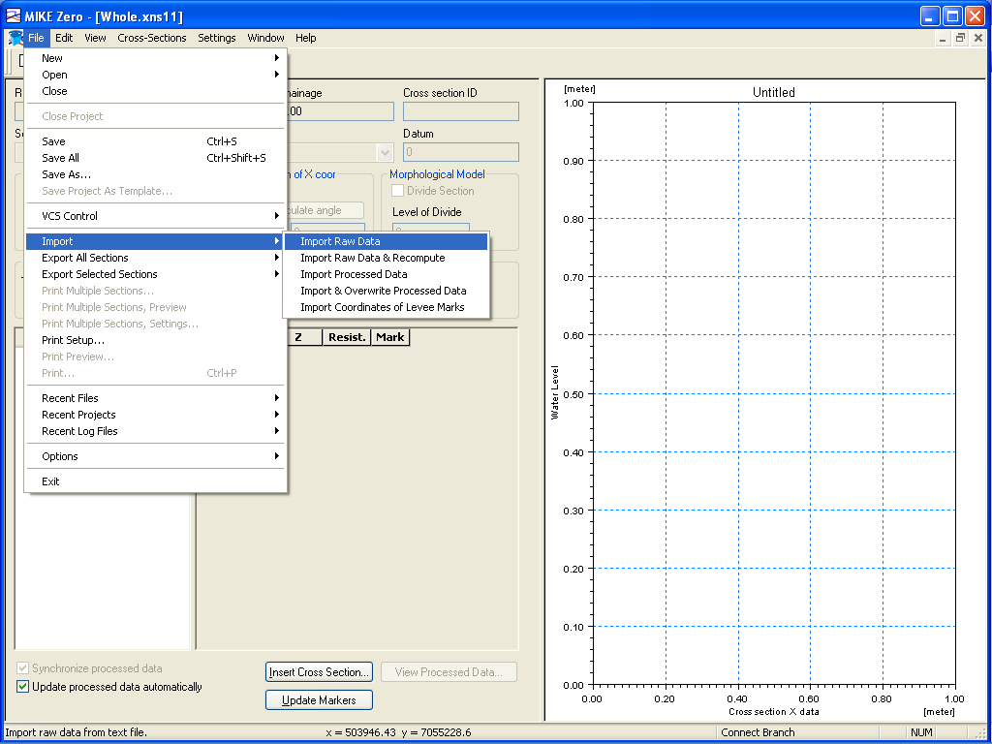
CROSS SECTION EDITOR
File Options (includes Import and Export)
How? MIKE Zero -> File
Import Raw and Processed Data
From ASCII

Slide 6
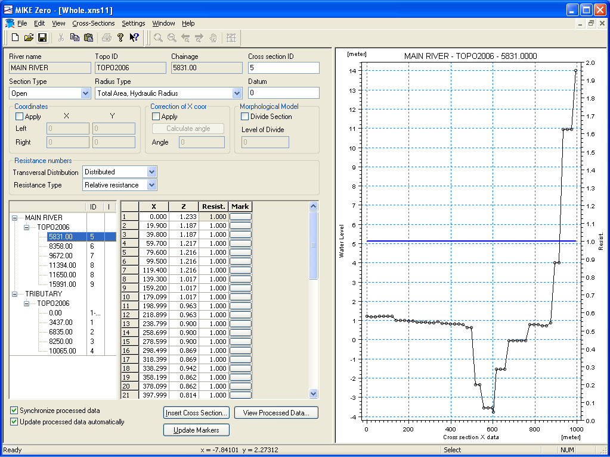
CROSS SECTION EDITOR
Raw Data View (Five Editing Panels)
1. Properties
2. Tree
3. Tabular
4. Functions
5. Graphical
1
2
3
4
5

Slide 7
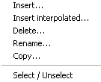
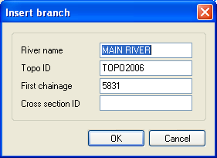
CROSS SECTION EDITOR
Raw Data View (Tree Panel)
Full Right Click
Functionality at Each Tree Level

Slide 8
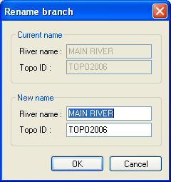
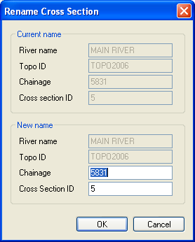
CROSS SECTION EDITOR
Tree Panel (Right Click Rename)
Branch Level
Section Level
Rename Branches
and Cross-Sections

Slide 9
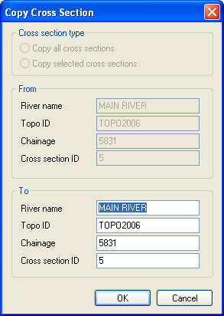
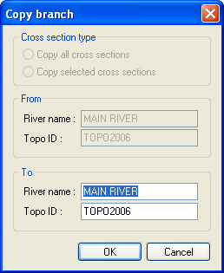
CROSS SECTION EDITOR
Tree Panel (Right Click Copy)
Section Level
Branch Level
Copy Branches
and Cross-Sections

Slide 10
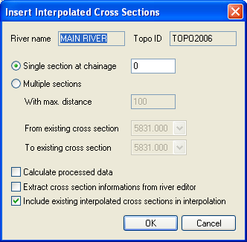
CROSS SECTION EDITOR
Tree Panel (Right Click Insert Interpolated)
Interpolate Single or Multiple Cross-Sections

Slide 11
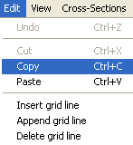
CROSS SECTION EDITOR
Edit Options (Applies to Tabulated Data Panel)
How? MIKE Zero -> Edit

Slide 12
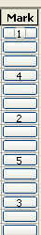
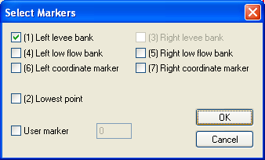
CROSS SECTION EDITOR
Tabulated Data Panel (Bank Markers)
Bank Markers Affect the
Calculation of Processed Data
Bank Markers are Displayed
in Graphical View
Five Commonly
Used Bank Markers

Slide 13
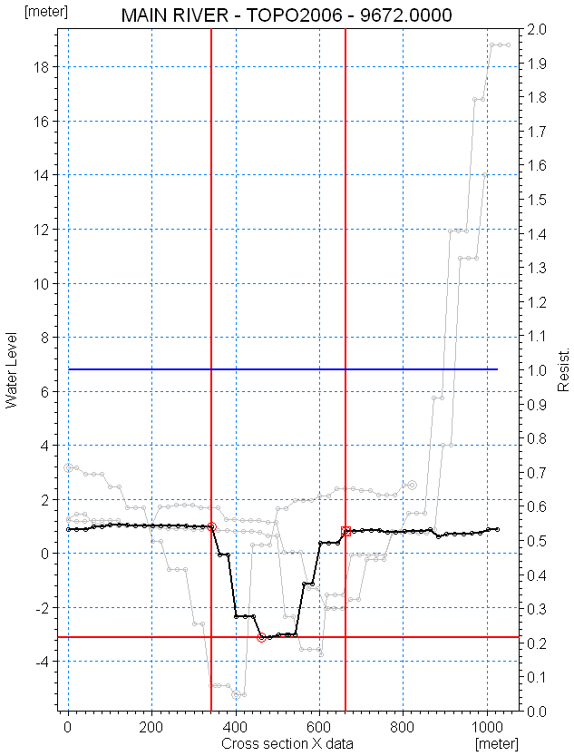
CROSS SECTION EDITOR
Raw Data View (Graphical Panel)
Bank Markers 1 & 3:
Determines Effective Area of cross section to be included in simulation
Effective flow area
Plot of Section
(looking D/S)

Slide 14
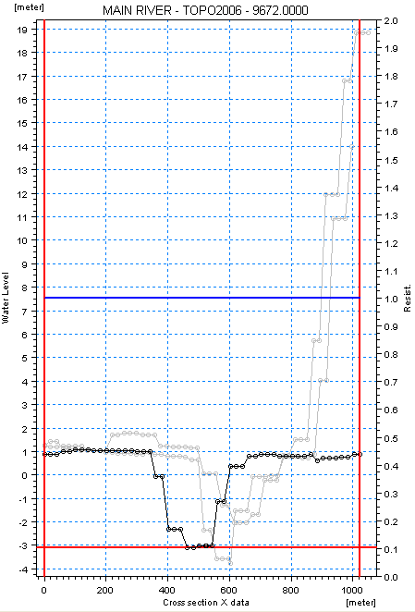
CROSS SECTION EDITOR
Raw Data View (Graphical Panel)
Bank Markers:
Displayed as Red Lines
Can be Assigned Directly
in Graphical View
Lateral Resistance:
Displayed as Blue Line
Units on Right Axis
Bed Level:
Left Axis Denotes Level
Each Row in Table Assigned
a Point in Graph
Cross-Section History
Displayed as Grey Shadow
Plot of Section
(looking D/S)

Slide 15
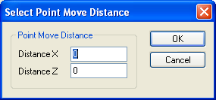
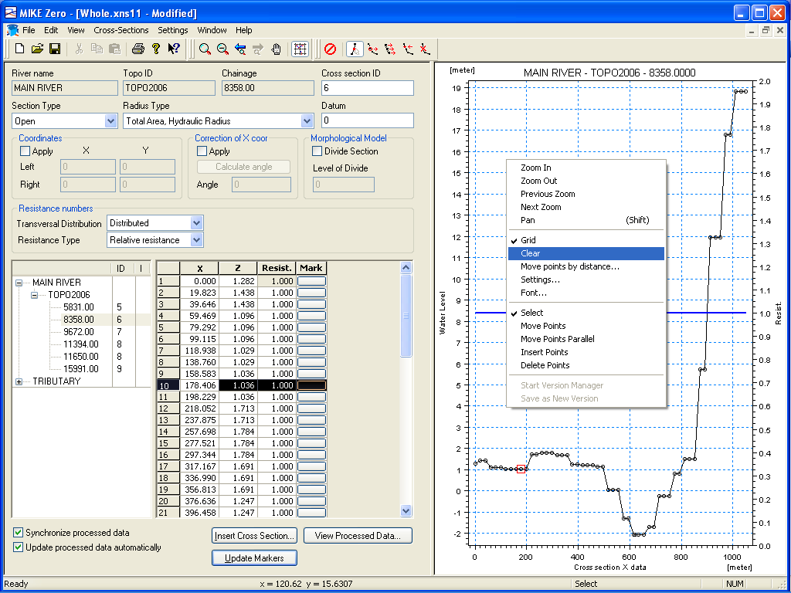
CROSS SECTION EDITOR
Graphical Panel (Right Click Menu and Tools)
Clear Grey Shadow
Cross-Section History

Slide 16
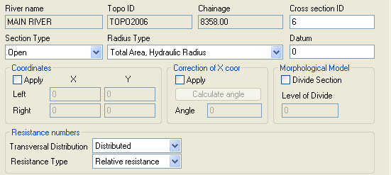
CROSS SECTION EDITOR
Raw Data View (Properties Panel)

Slide 17
CROSS SECTION EDITOR
Properties Panel (Summary)
Section Type: Open / Closed (Irregular, Circular, Rectangular)
Cross section ID: User defined text identifier
Datum: Reference level (m)
Radius Type: Resistance or Hydraulic Radius (Total or Effective Area)
Coordinates: Manual Override of Default Display of Extents
Resistance:
Transversal Distribution - Uniform, High/Low flow zones, Distributed
Resistance Type - Relative Resistance (multiplier of section value)
- Manning’s n and M
- Chezy Number, Darcy-Weisbach (k)

Slide 18
CROSS SECTION EDITOR
Radius Type (Resistance versus Hydraulic)
Different formulation due to different assumptions about
the Bed Shear Stress distribution across the river bed
Resistance Radius:
Resistance radius formulation is used.
Hydraulic Radius:
- Total Area uses raw
section geometry
- Effective Area includes
adjustment based on
relative resistance variation
τo
τo

Slide 19
CROSS SECTION EDITOR
Radius Type (Resistance versus Hydraulic)
B
A
y
P
Resistance Radius:
Hydraulic Radius:
Smoother transition from deep to shallow in processed data tables
Includes more accurate side wall effects in deep narrow channels

Slide 20
CROSS SECTION EDITOR
Bed Resistance
Formulations:
  Manning-Strickler M [m^{1/3} /s]
  Manning’s coefficient n(= 1/M) [s/ m^{1/3}]
  Chezy’s coefficient C [m^{1/2} /s]
Relative resistance:
Resistance Number = Resistance factor * Bed Resistance number
(Cross section database) (HD Parameter file)
(default: = 1.0) (default: M = 30)

Slide 21
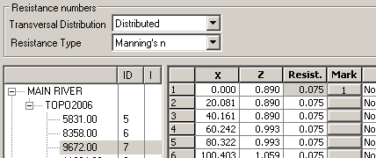
CROSS SECTION EDITOR
Resistance definition
Absolute Resistance:
Z
Flood plain
n=0.075;
Channel
n=0.025
Flood plain
n=0.075
X

Slide 22
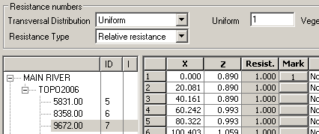
CROSS SECTION EDITOR
Resistance definition
Relative Resistance:
Z
Flood plain
n=0.075, r=3
Channel
n=0.025, r=1
Flood plain
n=0.075, r=3
X

Slide 23
CROSS SECTION EDITOR
Functions Panel
Dynamic Links to Processed Data
Updates Markers in Selected
Cross-Section:
(1) Furthest Left Extent
(2) Lowest Point
(3) Furthest Right Extent
Opens Processed Data View

Slide 24
CROSS SECTION EDITOR
Processed Data View (Definition)
Processed Data View includes:
Tree View listing of all Cross-Sections
Tabular Data of all hydraulic parameters
Graphical View of the selected parameter
For Each Section:
Area, Hydraulic Radius, Storage Width & Conveyance calculated for different water levels
Additional Storage Area (optional)
Resistance Factor (optional)
User can Control the Density of Processed Data Points

Slide 25
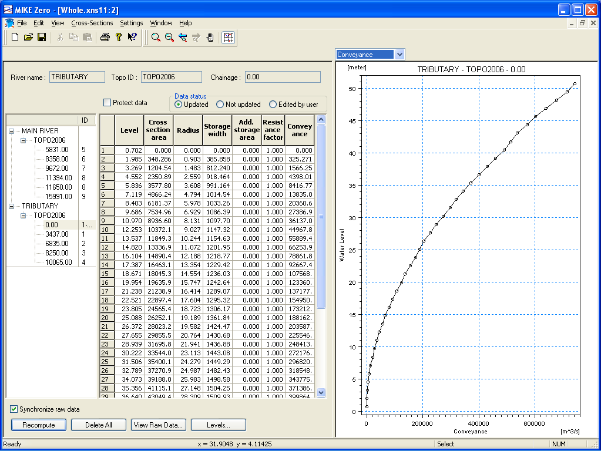
CROSS SECTION EDITOR
Processed Data View (Overview)
How? ”View Processed Data” Button in Raw Data View
Select Item to Plot
Similar Layout and Functionality as the Raw Data View
Graphical View is Right Click Enabled

Slide 26
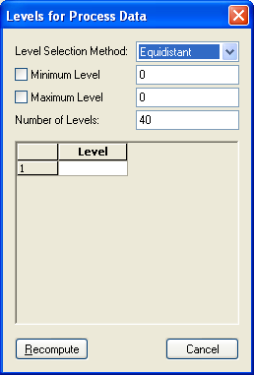
CROSS SECTION EDITOR
Processed Data View (Functions)
Protects Manually Changed/Added Data from Automatic Update
Switch Back to Raw Data
Recompute All
Options for Density and Distribution of Processed Data Points:
Automatic
Equidistant
User Defined

Slide 27
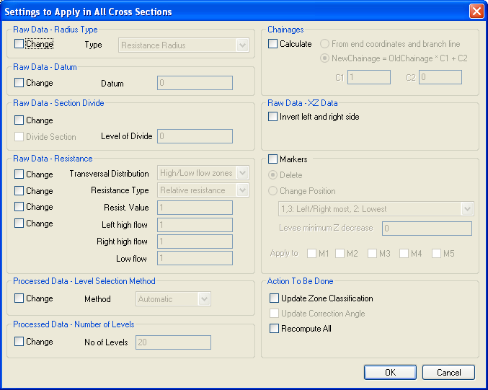
CROSS SECTION EDITOR
Cross-Section Options (including Global Edit)
How? MIKE Zero -> Cross-Sections -> Apply to All Sections
NOTE
Great for ensuring, that all cross sections have been precalculated prior to initiating the simulation
Apply Global Changes to Raw and Processed Cross-Section Data

Slide 28
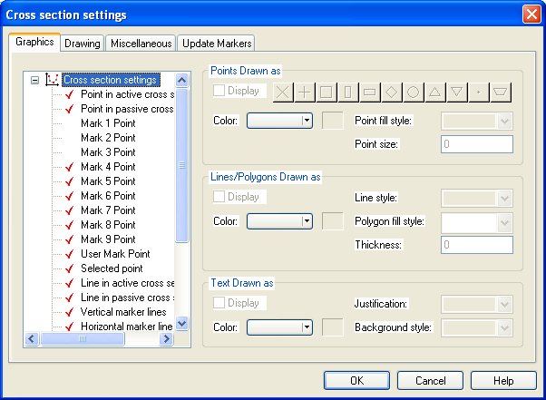
CROSS SECTION EDITOR
Setting Options (Graphics)
How? MIKE Zero -> Settings -> Cross-Section
Change the Appearance of Objects in the Graphical View

Slide 29
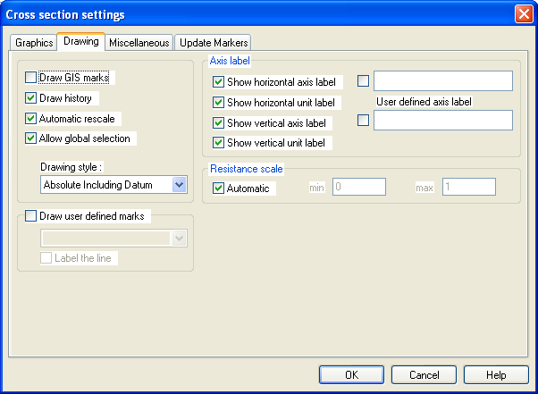
CROSS SECTION EDITOR
Setting Options (Drawing)
How? MIKE Zero -> Settings -> Cross-Section
Change the Drawing Options for the Graphical View

Slide 30
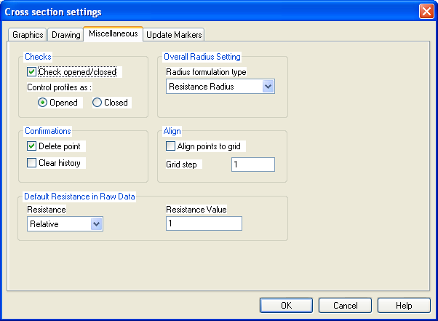
CROSS SECTION EDITOR
Setting Options (Miscellaneous)
How? MIKE Zero -> Settings -> Cross-Section
Miscellaneous Settings including Default Values

Slide 31
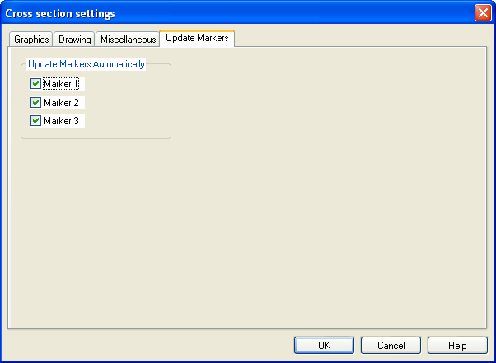
CROSS SECTION EDITOR
Setting Options (Update Markers)
How? MIKE Zero -> Settings -> Cross-Section
Change Markers that are Automatically Updated

